Slide 1
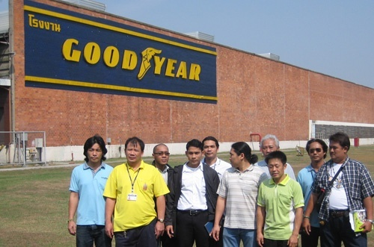

Goodyear Thailand
Continuously “difficult”
No water, but his coffee
No shake hands
Secrete recording

Slide 2
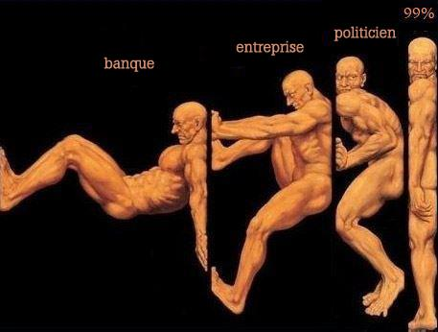

Slide 3
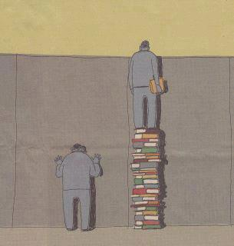

Slide 4
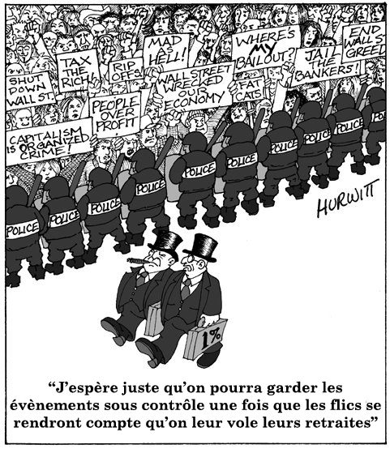

Slide 5
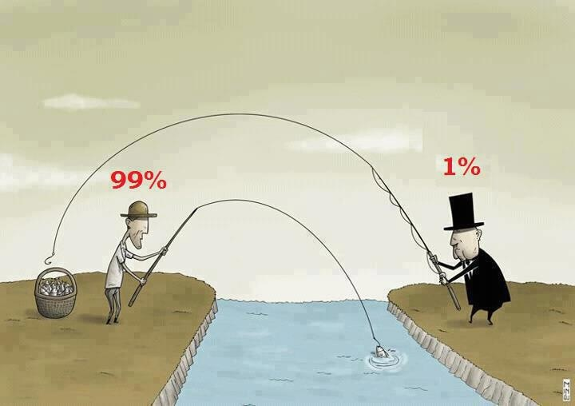

Slide 6
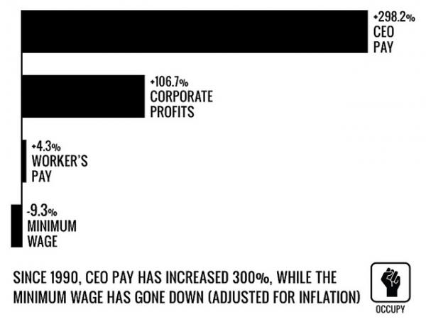

Slide 7
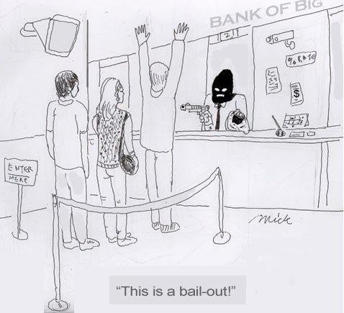

Slide 8
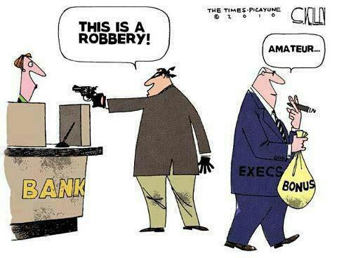

Slide 9
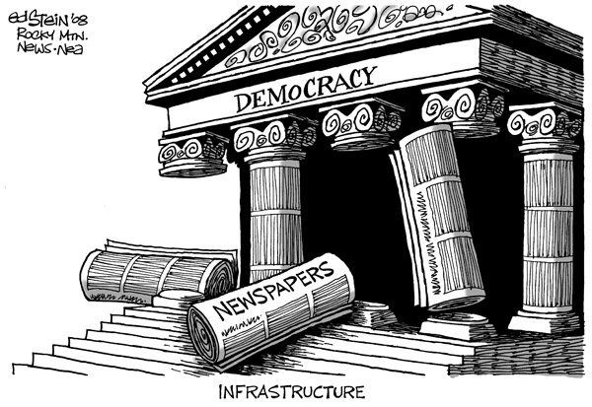

Slide 10
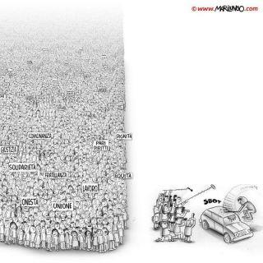

Slide 11
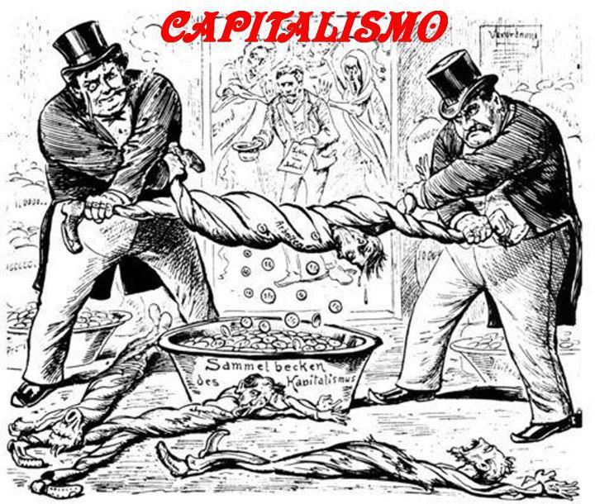

Slide 12
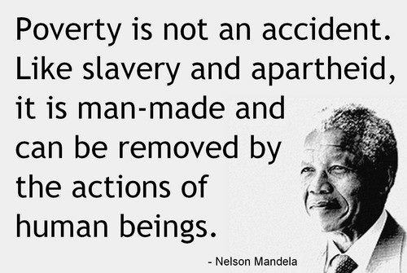

Slide 13
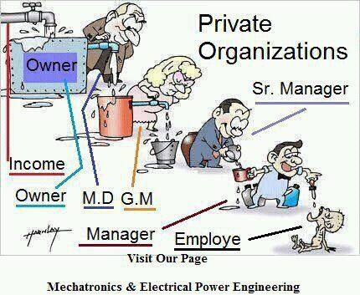

Slide 14
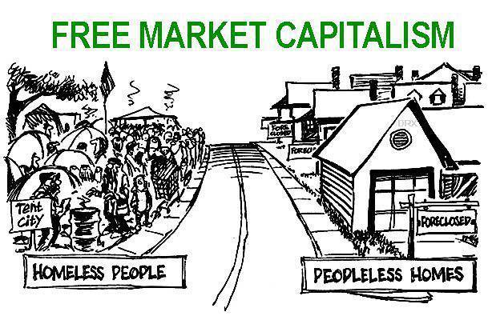

Slide 15
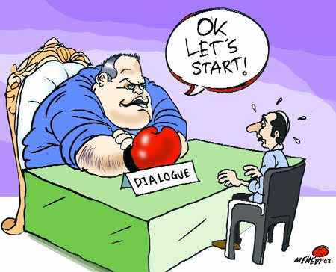

Slide 16

Group Discussion

Slide 17
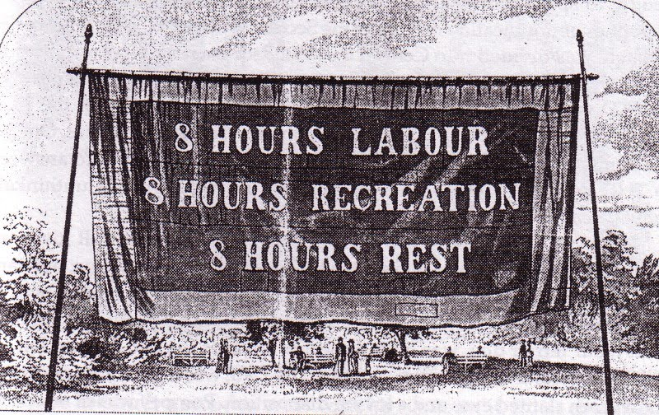
8 hours work
8t hours labour, 8 hours recreation, 8 hours rest
Formulated by Robert Owen (1771-1858)

Slide 18
Factory Acts in UK
Factory Act 1802
Factory Act 1844
Children between the ages of 9 and 13 can work maximum 8 hours.
The work hours of children must begin after 6 a.m., end before 9 p.m., and not exceed 12 hours a day.
Adolescents between 14 and 18 years old can work maximum 12 hours
Male and female children must be housed in different sleeping quarters.
Children 9–13 years could work for 9 hours a day with a lunch break.
Women and young people work for no more than 12 hours a day during the week, including one and a half hours for meals, and 9 hours on Sundays.
Factory owners must wash factories with lime every fourteen months.
Ages must be verified by surgeons.
Accidental death must be reported to a surgeon and investigated.
Thorough records must be kept regarding the provisions of the act.
Machinery was to be fenced in.

Slide 19
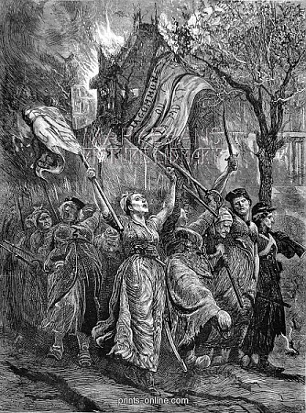
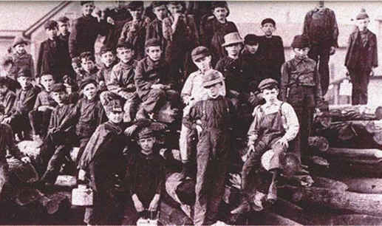
Factory Act 1847 in UK
women and children 13-18 could work only 58 hours per week, which is the equivalent of 10 hours per day.
10 hour work a day for women and children
The results of “10 hour movement”

Slide 20
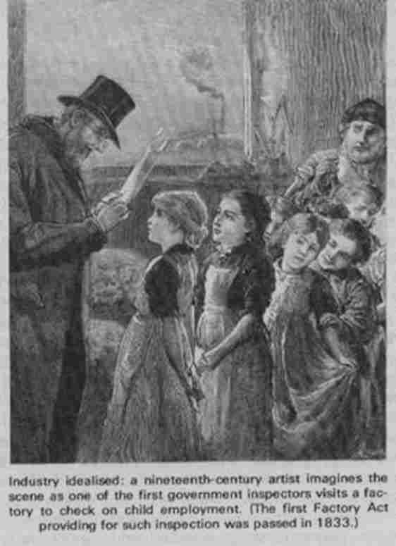
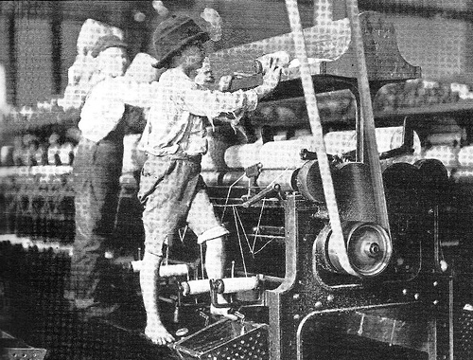
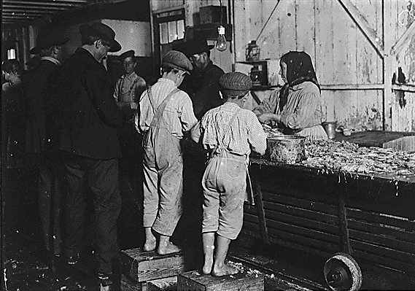

Slide 21
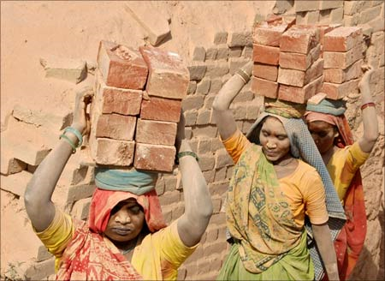
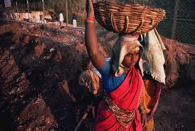
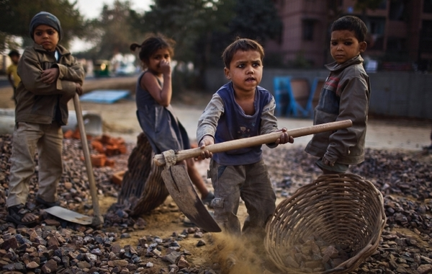
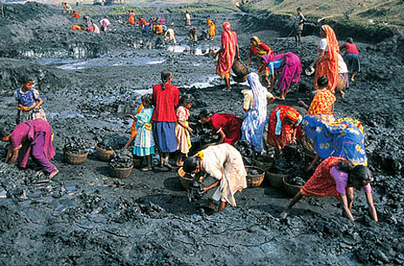

Slide 22
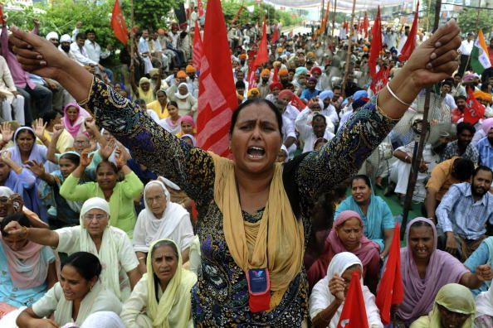

Slide 23
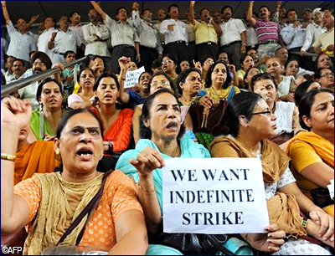
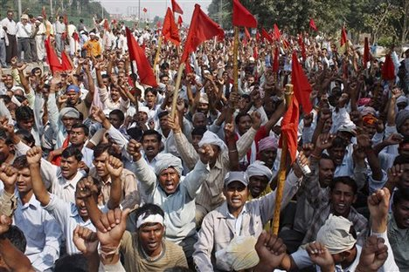
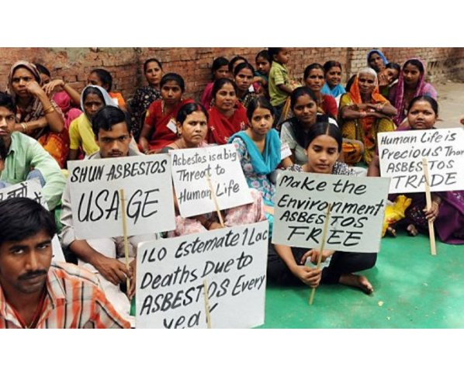
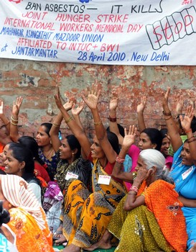

Slide 24
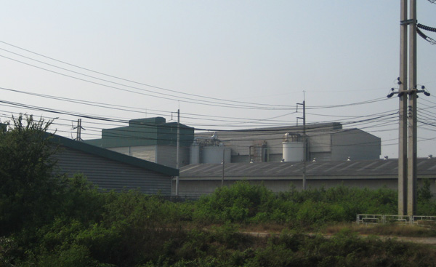
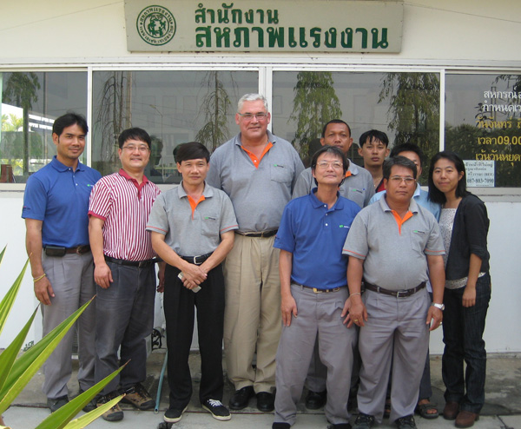
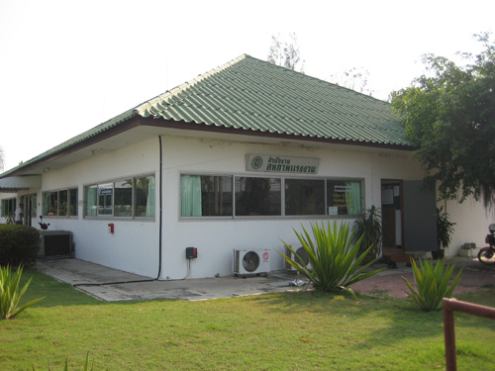
Norske Skog Thailand

Slide 25
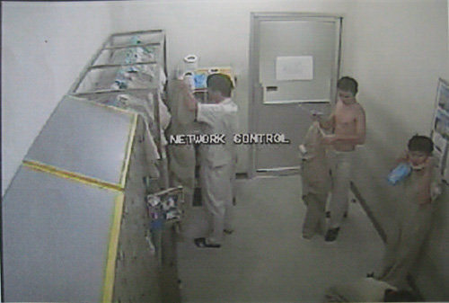
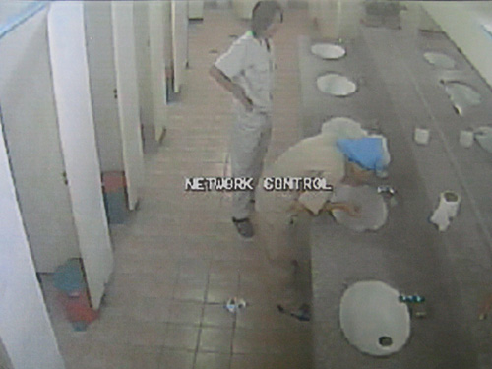
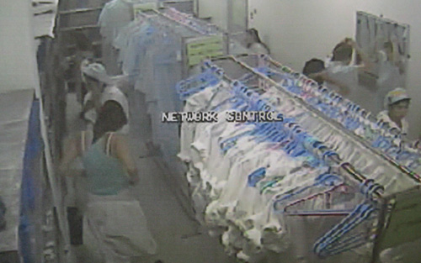
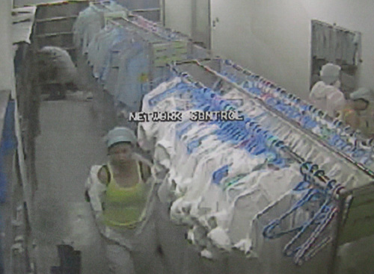
Hoya Thailand

Slide 26
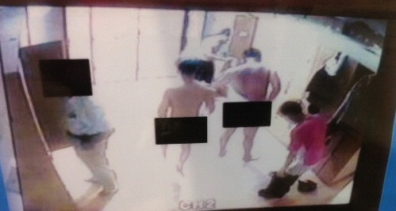
DKC Korea, CCTV since 2008 industrial cable company,

Slide 27
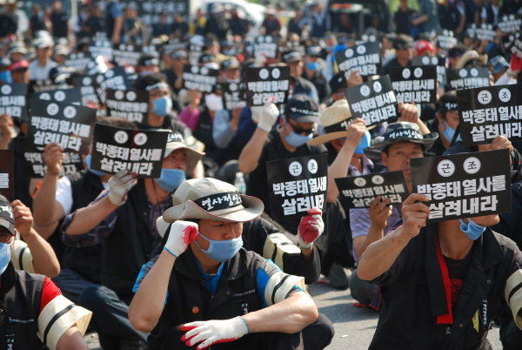

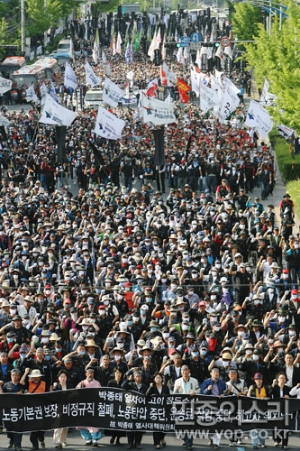
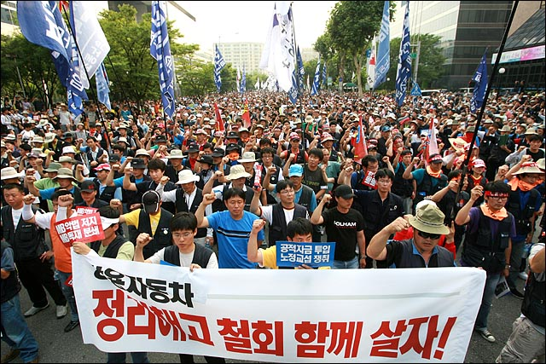
What happen in Korea ?

Slide 28
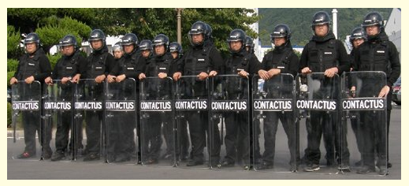
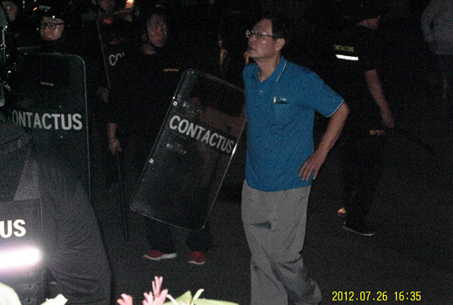
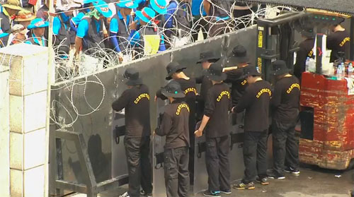
Private manpower company to kill union strike

Slide 29
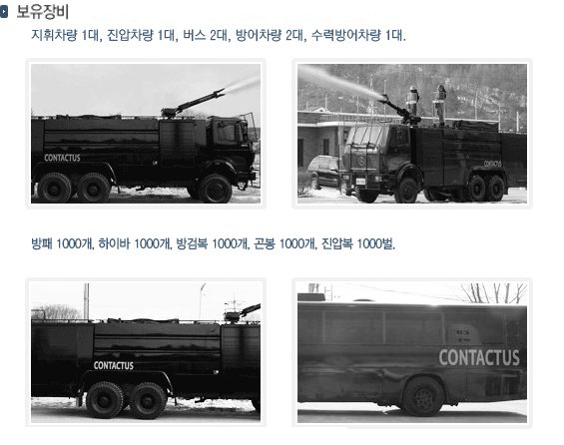
Private manpower company kill union strike

Slide 30
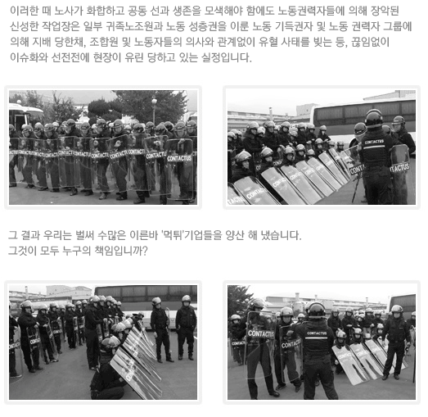
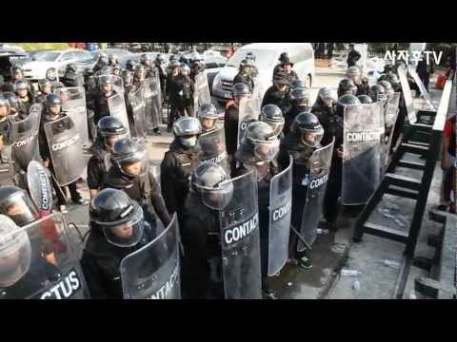
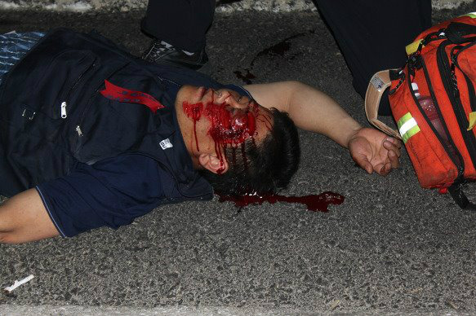
Private manpower company to kill union strike

Slide 31
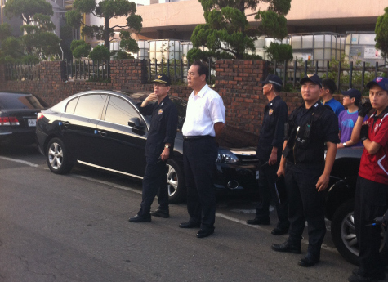
What police chief is doing?

Slide 32
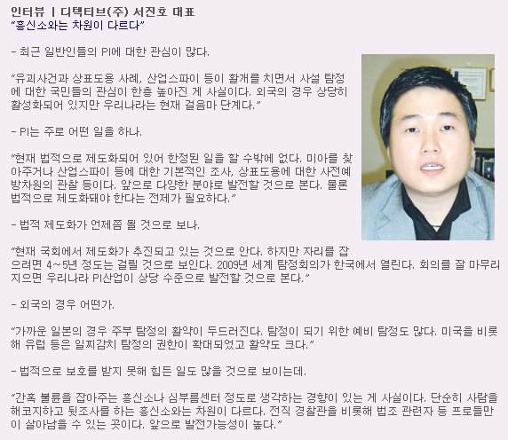
2007/4

Slide 33




Riot police in Korea

Slide 34

Go together

Slide 35

Chartism
1839 in UK

Slide 36

Part-time union officer, Harry

Slide 37
Paid Union Leader in Korea
Hyundai Motor (Metal Union Branch) has 225 full-time union officers paid by management, as of 7 April, 2011.
According to the government decree, the number of the full-time union leaders paid by the management must be 24 persons. (in case of part-time union leaders, the number can be 48).
The changed labor law has been effective from 2011.

Slide 38
Union Representatives in Norway
Up to 25 2 reps.
26~50 3 reps.
51~150 4 reps.
151~300 6 reps.
301~500 8 reps.
501~750 10 reps.
Over 750 12 reps.
Information
Consultation
Negotiation
Recruitment
Monthly meeting with management
Monitor CBA
Time-off (paid)
Facilities

Slide 39


Union office of Kumho Tire

Slide 40

Union board of Kumho Tire

Slide 41
Union office inside factory
(Norske Skog
Thailand)

Slide 42
Morning Exam
What is the full name of ILO?
When was ILO established?
What is the role of ILO?
How many member countries in ILO?
How many ILO Conventions totally?
How many ILO Core Conventions?
Please explain about the contents of each ILO Core Convention.
How many ILO Core Conventions ratified by your country?

Slide 43
What we will do
Compare collective agreement with international standards
Report back to our members
Educate members about international standards
Study about labor laws with members
Learn how to use internet and email
Phone and email seminar participants
Email to us
Making our network

Slide 44
www.ilo.org
www.icem.org
www.unglobalcompact.org
www.oecd.org

Slide 45
Mobile phone
Email
Internet (Facebook)

Slide 46
Individual evaluation
What was the most interesting and helpful to you in the seminar?

Slide 47
ICEM
Yoon Hyowon icem.asia.mnc@gmail.com
Din
chikdin@gmail.com

Slide 48
Self introduction
Name
Company & position
Union & position
Family
Dream 10 years later

Slide 49



Slide 50


Lafarge Belawan plant, Indonesia

Slide 51


Who makes KIA Morning
KIA workers?
Donghee Auto
So, Donghee Auto workers?

Slide 52

KIA Morning
KIA’s contractor, Donghee Auto
17 subcontractors of Donghee Auto
900 subcontract workers of 17 subcontractors
1-year contract and 4110 KRW an hour, but 44 cars an hour (highest productivity)
900 workers of 17 subcontractors of Donghee Auto contractor of KIA MAKE KIA Motor !!!!

Slide 53


We want to meet our employer

Slide 54


Slide 55
bam_binice@yahoo.com
0935134890
icem.asia.mnc@gmail.com

Slide 56


Slide 57


Slide 58


Slide 59


Slide 60
EATON and EIWU
Recognition of the company
The Union recognizes the right of the company to operate and manage its business in all aspects, and, in particular, without derogating from the generality of the foregoing, to determine the numbers and deployment of the workforce and the content of jobs, to establish rules and regulations on operations and safety, to determine the efficient utilization of the force, tools and equipment, the means, methods, processes, materials, procedures of production, to engage, promote, retrench, transfer, discharge, suspend or otherwise discipline any employee for cause subject to the provisions of any law for the time being in force. In exercise of its management functions, the company shall not breach any of its obligations under the terms of this Agreement.

Slide 61
LINATEX and NEUCMRP
Recognition of the union
The company recognizes the union as the exclusive bargaining agency in respect of and on behalf of all employees who are eligible for membership, with the exception of the following categories.
  Managerial capacity
  Executive capacity
  Confidential capacity
  Security capacity
  Temporary employees employed, for a period of up to 6 months only.

Slide 62
Lafarge Indonesia
If workers lost the safety equipment by themselves, they are provided with the equipment by Lafarge, but their salary is cut with the amount of the equipment cost.

Slide 63

Holcim India, Coimbatore 2011.5.11

Slide 64

Holcim India, Coimbatore 2011.5.11

Slide 65

Indocement Indonesia, Samarinda2011.6.4

Slide 66

Thiess Contractors Indonesia, Samarinda2011.6.4

Slide 67
Washington Post, 19 June 2011
Top 0.1% (152,000 people) occupy 10.4% of national income in USA as of 2008, which was 2.6% in 1975.
Jobs of Top 0.1%: CEOs, lawyers, real estate investors, medical jobs
Yearly income is 5.5 million USD per a rich people, increased by 385%, compared with 1970.
Bottom 90% (137.2 million people): average income is 31,244 USD, decreased by 1%, compared with 1970.
Remuneration for CEOs had increased by 430% between 1970 and 2005, while workers’ wage increased by 26% and company income did by 250%.
Top 0.1% occupy 4% of national income in UK, 2% in France and Japan.

Slide 68
Star Educate, 9 June 2011
Polls with 4000 workers in 14 countries
Do workers feel ?
  skills are properly utilized
  Career paths open to workers
  Training and career development opportunities provided
Singapore was the last in
  Workers enjoy going to work
  Loyal and supportive workplaces

Slide 69
Star Educate, 9 June 2011
Singaporean workers feel that
  17% see themselves staying with their current employer forever (35% of global average)
  19% look forward to their work each day (30% of global average)
  12% feel workplace positive and supportive (20% of global average)
  Lack of transparency and consistency

Slide 70
Group discussion
2 groups at company level
1 group at provincial level
40 minutes
What are the most serious and urgent issues in our company?
What are the most serious and urgent issues in our province?
What should we do for improving the situation?

Slide 71
Introduction question
Name:
Age:
Family:
Company / position
Union position
What discontents do you feel in your company?
What anxiety do you feel in your life?
What is your dream in 10 year later?

Slide 72
Demands for collective bargaining
Program for 3-day strike
What support we need from the federation and industrial zone union?

Slide 73




Slide 74
ll000000

Slide 75
000000ll

Slide 76
ll

Slide 77
What is the strong points of industrial federations?
What is the weak points of industrial federations
What we want from industrial federation?
What we want from national confederation?

Slide 78
What are the strong points and weak points of Indonesian trade unions in comparison with Korea and Sweden?
How to strengthen union finance at company and industrial levels?
What we should to make joint preparation for CBA at city, provincial and industrial level?

Slide 79
what are the main problems, obstacles and weak points in trade union activity and collective bargaining?
  Company level
  Provincial federation and industrial zone union level
  Industrial union level

Slide 80
What are the benefits of trade union activities at factory level?
Nhung loi ich tu hoat dong cong doan co so?
2. What are the difficulties of trade union activities at factory level?
Nhung kho khan trong hoat dong cong doan co so?
3. What we need, what we want from the Federation of Labour?
Chung ta can gi va muon gi tu LDLD tinh?

Slide 81
What are the benefits of trade union activities at factory level?
2. What are the difficulties of trade union activities at factory level?
3. What we need, what we want from the Federation of Labour?

Slide 82
Group Work
What are the strong points of our trade union at workplace?
2. What are the weak points of our union at workplace?
3. What we need, what we want from industrial federation, upper-level union?

Slide 83
Group Work
In order to establish a TRUE social dialogue with management
in order to implement international standards,
in order to protect and organize agency workers,
in order to strengthen union at workplace?
In order to establish union solidarity in Thai tirecal industry
What difficulties (obstacles, problems) our unions face at workplace? Weak Points
What resources (powers, tools, “weapons”) our unions have at workplace? Strong Points
What is to be done by our unions?

Slide 84
Email: cyrillepoughon_cemcfe@yahoo.fr

Slide 85
Make the collective bargaining demands with international standards.
Make the Program for 3-day strike for members.
Make the education program for union members concerning international standards and Collective bargaining.

Slide 86
One organization, one CBA
Common/joint training
Common/joint bargaining
Common/joint struggle
Dream
Plan, study, visit, discussion, forum
educate
1988, 1998, 2004

Slide 87
Self Introduction
Name
Company / Position
Union / Position
Age
Family
Dream 10 year later

Slide 88
Self Introduction
Name
Company / Position
Union / Position
Age
Family
Dream 10 year later

Slide 89
industrial unionism
25-26 October, 2011
Jakarta, Indonesia

Slide 90
union activity
educate
struggle
bargain
organize

Slide 91
忠恕
忠 Chung
loyal to members
中 (central; keep in)
心 (mind)
Keep members in the center of mind
恕 Seo
forgive members
如 (same)
心 (mind)
Have the same mind with members
Keep the same mind of members in your mind

Slide 92
Socialist system the role of trade unions
Efficiency
Productivity
Protect workers
Government

Slide 93
Transition period the role of trade unions
Efficiency
Productivity
Protect workers
Government

Slide 94
Market economy system the role of trade unions
Protect
Workers
Efficiency
Productivity

Slide 95
Workers representative at workplace
Employees representatives
Union
representatives
Employed by company
Elected by all employees
Existing inside company
No upper-level organizations
Information, consultation
No bargaining power
Only economic roles for employees
Employed by company
Elected by union members (employed)
existing inside and outside company
Affiliation to upper-level organizations
Information, consultation
Bargaining power
Economic, social and political roles

Slide 96
Workers representative at workplace
Employee
representatives
Union
representatives

Slide 97
Procedure of Strike in Korea
Negotiation is broken.
Direct and secret votes by members
Votes by a majority of members (50% plus 1 member)
Union must inform employer of the labor dispute
Union must request Labor Relations Commission to make the mediation (or the arbitration).
  10 days in general sectors
  15 days in the essential public services (railway, subway, airplane, water, electricity, gas, oil refinery and supply, hospitals, blood supply, central bank, telecommunication)
  Mediation Committee: 3 persons (union, employer, public interest)
  Special Mediation Committee for essential public services
Arbitration
  In case both party of union and employer request the commission to make the arbitration
  In case there is an article on the arbitration request stipulated in CBA

Slide 98
Thao
Bam_binice@yahoo.com
093 5134 890

Slide 99
IF Metall
History of IF Metall
1888 Swedish Metal workers union
1915 - 1948 lot of mergers
1993 Sv. Metal workers and Miners union
2006 Industrial union and Sv Metall workers became IF Metall

Slide 100
IF Metall
350 000 members
40 000 representatives
52 regional offices
12 500 workplaces
70 % organization rate
1.76 % membership fee in average 350 SEK
Extra fee for unemployment fund 250 SEK

Slide 101
IF Metall
41 national collective agreements
Regulation on employment, minimum wages, working hours, rules for piece-rates and monthly wages, overtime pay, insurance, holiday pay

Slide 102
Union Officers as Trainer
No Education, No Union: Active training is a starting point for strong union
Start with small group (maximum 10 persons) in short time (maximum 1-hour: 30-minute presentation and 30-minute discussion)
Go head step by step, but consistently
Holistic approach: trainer is organizer, policy maker and negotiator.
Interaction approach: Make workers/trainees speak, Learn from workers
Learn and utilize IT/computer skills: email, internet, Power Point, photos/pictures

Slide 103
Union Officers as Trainer
Have daily or regular contacts (meetings, visits) with workplaces
“No Survey, No Speak” – Mao: Study the issues of labor, society, economy and politics to get training materials and topics
No need to be theoretical, but need to be practical and pragmatic
Establish and continue networking (phone, SMS, emails, Facebook, blogs)with workers and union leaders
Best way to learn and master is to teach
Practice! Practice! Practice!

Slide 104
Team Homework
ILO Standards
  2-page report on 18 ILO Conventions ratified by Vietnam (name and key points)
CBA
  Collect and analyze best 5 CBAs existing.
  2-page report on the analysis of the 5 CBAs

Slide 105
Preparation for next training
  Learn about basic skills of Power Point from your colleagues)
  Make 10 minute- PPT file on introduction of your FOL
  Bring a laptop computer (at least 1 federation)
  Brining the copy of 5 CBAs collected

Slide 106
Questions in Vietnam
What are the main reasons that most of CBAs are the just replication of laws?
What are the upper-level unions doing in collective bargaining, currently?
What is to be done by upper-level unions for better collective bargaining at workplace-level?
Trade union is a fighting organization or an labor-administrative organization (improve productivity) ?

Slide 107
Group Discussion
What type of union leaders we like?
What type of union leaders we dislike and hate?
What are the problems and weak points of industrial federations?
What we want and need from industrial federations ?

Slide 108
Go together

Slide 109
Ruling of Korean supreme court
illegal form of agency work
Job which is done in automatic flow using conveyer belt.
Job which uses the facilities and components owned by Hyundai Motor
Job which is done by instruction cards (job order) of Hyundai Motor
as of 2012 September, 6800 agency workers inside Hyundai Motor

Slide 110


Slide 111

Hydrofluoric Acid
September, Korea

Slide 112


Slide 113

Mistake by workers, or wrong practices by company

Slide 114

Women subcontract workers,
Hyundai Motor, Rest time at 02:00

Slide 115

Subcontract workers with blue vest, Hyundai Motor

