Slide 1
Trade Unions and Labor Relations in Germany
Yoon Hyowon
IndustriALL Global Union
industriallyoon@gmail.com

Slide 2
Overview on Germany
Population: 81,802,000 (in 16 states)
Coverage rate of CBA: 62%
Union density: 19%
Level of collective bargaining: industry
Workers representatives at workplace: Works Council
Workers representatives at company governance: Supervisory Board
Dual system of company governance: Board of Directors and Supervisory Board

Slide 3
Overview of trade unions in Germany
Unionized workers: 7.4 million (including retirees)
Union density (2011): 18%
German Confederation of Trade Unions (DGB): 6.15 million members (2012)
German Civil Servants Federation (DBB): 1.26 million members (2013)
Craft unions: doctor union, pilot union
Christian Federation of Trade Unions(CGB): 280,000 members (2011)

Slide 4

German Confederation of Trade Unions (DGB)
Established in 1949
6.15 million members
8 national unions
  IG Metall (metal): 2.24 million members, 36.48%
  Verdi (white-collar, public sector): 2.07 mil., 33.64%
  IGBCE (chemical, mining, energy): 670,000, 10.92%
  IGBAU (construction, agriculture: 300,000, 4.97%
  GEW (education, science): 260,000, 4.27%
  EVG (railway): 220,000, 3.59%
  NGG (food, beverage, catering): 200,000, 3.34%
  GdP (police): 170,000, 2.79%
Strong union power in manufacturing sector rather than public sector

Slide 5
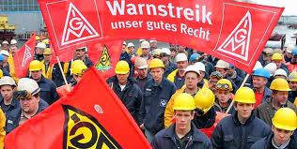
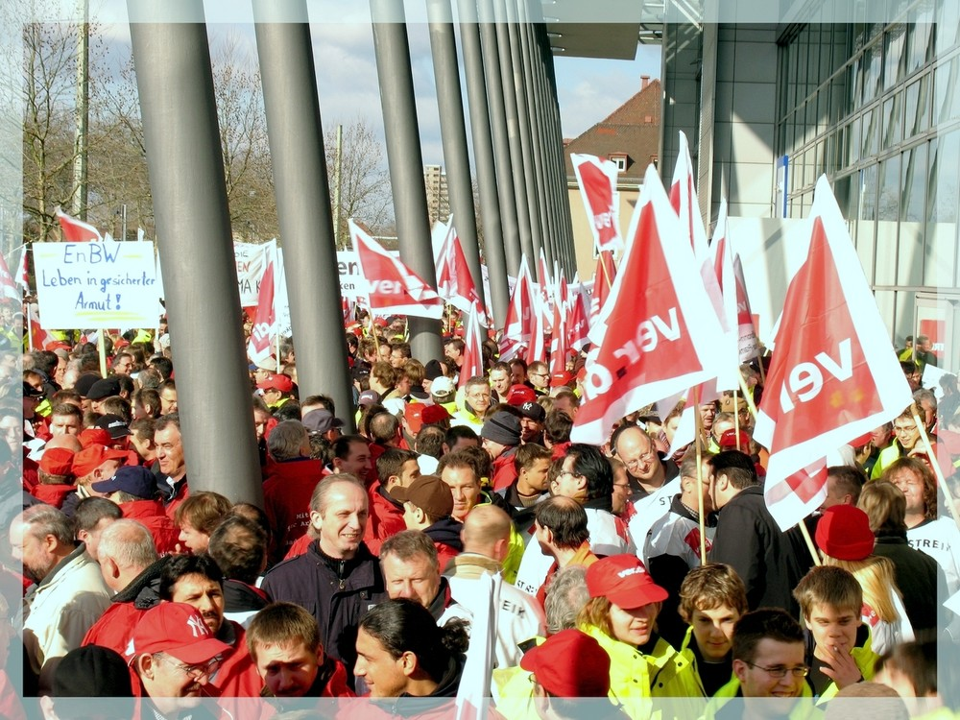
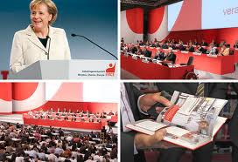

Slide 6
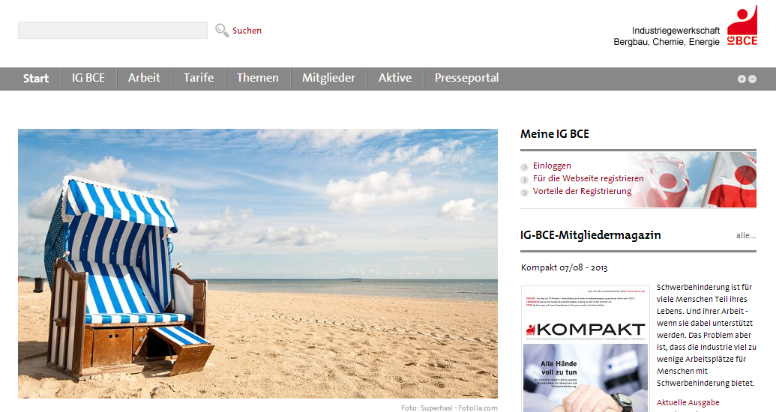

Slide 7
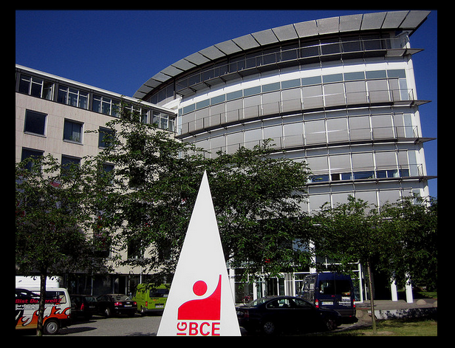
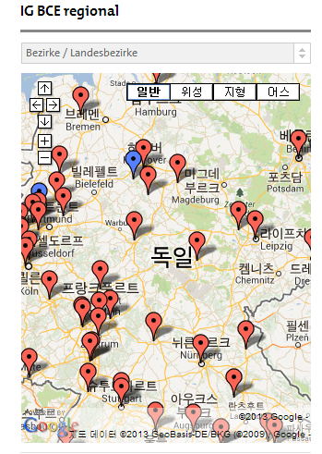

Slide 8
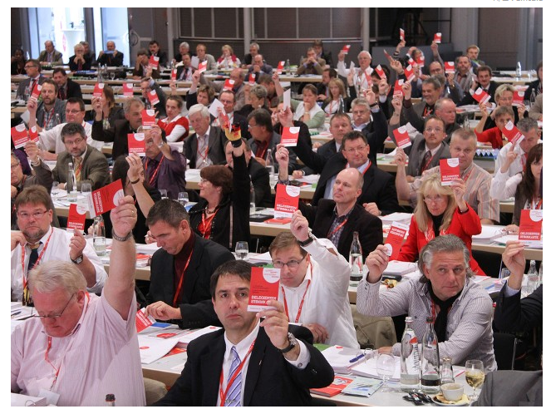
IGBCE (chemical, mining, energy)
675,000 members
44 regional offices
1,100 locals
27 departments: economic & industrial policy, social issue and labor market
National Congress every 4 years with 400 delegates
3,000 CBAs

Slide 9
Collective Bargaining
Industry-level: Negotiation between industrial unions (national unions) and employers association
Workplace-level: Works Council and individual employer
Registered CBAs: 68,000 CBAs (506 CBAs with general binding power)
C
A
D
B
E
F
H
G
J
I

Slide 10
Collective Bargaining
59%
CBA coverage
  national: 59%
  Former West Germany: 61% (industry 54%, company 7%)
  Former East Germany: 49%(industry 37%, company 12%)
General Binding Power
18%
10%
??
Union density
CBA coverage

Slide 11
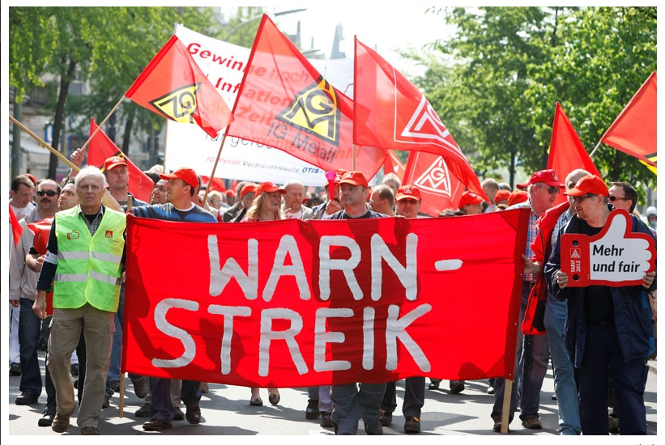

Slide 12
National union
Works Council

Slide 13
Works Council workers presentation at workplace
Statutory body by Work Constitution Act (1952)
Workplaces with 5 or more employees must establish works council.
90% of workplaces with more than 500 employees have works council.
10% of all the companies have works council.
40% of total workforce belongs to works council.
There is no legal relationship between works council and trade union.
77.3% of works council officials are DGB members.
Employers cover all the costs for works council.
Employers provide office and paid staff to works council.
Employers pay the costs for external experts and consultation fees.
Big-sized companies often pay the costs for full-time activists for works council, such as salary.

Slide 14
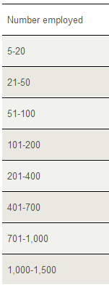
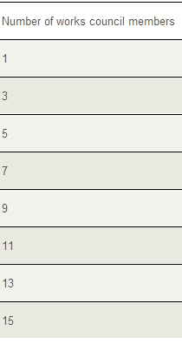
Works Council workers representation at workplace
Works council officials
Votes by all the employees
4-year term
7000~9000 employees: 35 officials
Paid full-time officials (time-off)
  Below 200: no legal provision
  200~500 employees: 1 full-timer
  501~900: 2 full-timers
  901~1,500: 3 full-timers
  1,501~2,000: 4 full-timers

Slide 15
Works Council
Consultation & information
codetermination
Employment issue
Merger & Acquisition
Demand and supply of workforce
Job training
Personnel issue: recruitment, appointment, evaluation, transfer, dismissal
Gender equality
No racial discrimination
Disciplinary issue
Start and end of working hour
Rest time
Temporary reduction or extension of work hours
Adjustment of holidays
Principle of wage payment (based on performance or seniority)
Installation of camera for measuring workers’ jobs or checking workers’ behavior
Introduction and operation of work facilities such as canteen and fitness club
Introduction of work plan and group work
Job training: trainees’ jobs, selection of trainees, veto to the selection of trainers
Making social plan in case of factory closure such as compensation

Slide 16
Safety Health Committee
Workplaces with 20 or more employees must set up safety health committee
Health safety staffs (unpaid)
  21-50 employees: 1 staff
  51~100: 2 staffs
  101~200: 3 staffs
  201~350: 4 staffs
  Every 200: plus 1 staff
Works council
  Approval of appointment and dismissal of workplace doctors and safety specialist
  Consultation on safety health worker
  Information on health & safety and accidents
  Monthly meeting
Safety health committee
(quarterly)
Employer representative
Works council representative
Safety health specialist
Health safety staffs

Slide 17
Governance of German companies
Shareholders meeting
Supervisory Board
Board of Directors

Slide 18

Employee representatives at supervisory board
Supervisory Board
Companies with 500~2000 employees: 1/3 of supervisory board directors must be worker representatives
Companies with more than 2000 employees: ½ of supervisory board directors must be worker representatives (including union official)
Appointment and dismissal of members of the board of directors and evaluation on their performance
Approval on the decisions and activities of Board of Directors
Company strategy development and advice on financial situation
Werner Wenning
Chairman of the Supervisory Board, Bayer Group

Slide 19

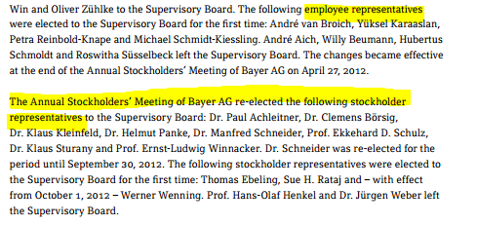
Bayer Group: Supervisory Board

Slide 20
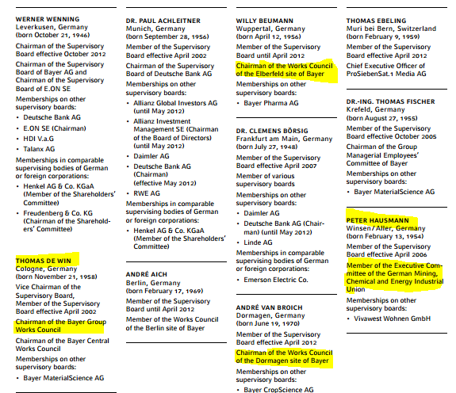

Slide 21
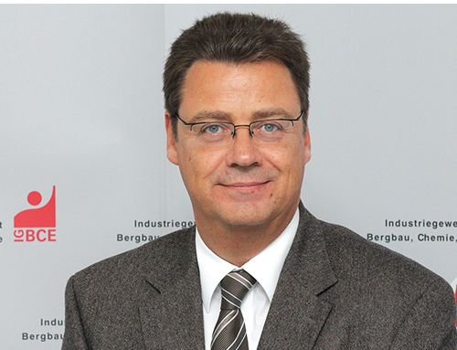

Slide 22
Supervisory Board
종업원평의회
종업원평의회
종업원평의회
종업원평의회
종업원평의회
종업원평의회
종업원평의회
Works Council

Slide 23
Comparison between Germany and Asia: Trade Union
National / Industrial Union
Company union

Slide 24
Comparison between Germany and Asia: Collective Bargaining
National / Industrial Union
Company union

Slide 25
Comparison between Germany and Asia: Workers Representation
Works Council
Supervisory Board
Company union

Slide 26
Comparison between Germany and Asia: Workers Participation
Information
Consultation
Codetermination
Company union

Slide 27
Implication for CBAs
Workers Interests
Workers Rights
wage
Working hours
allowances
Company welfare
Health & safety
Profit sharing
Freedom of trade unions
  Right to organize
  Right to collective bargaining
  Right to collective action
Right to health and life
Workers participation
  Information
  consultation
  codetermination

Slide 28
