Slide 1
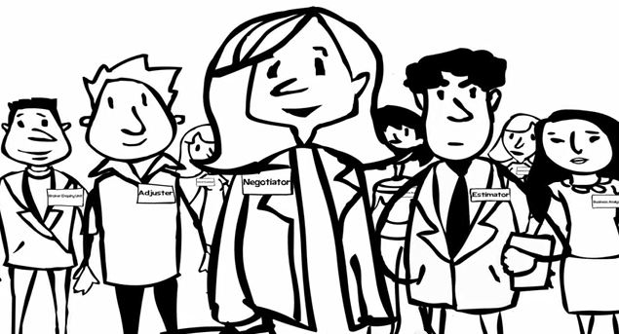
How to Make Collective Bargaining

Slide 2
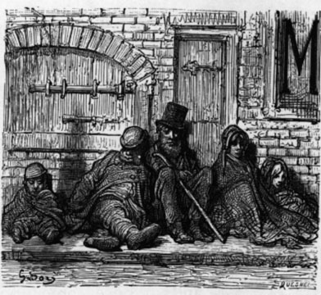
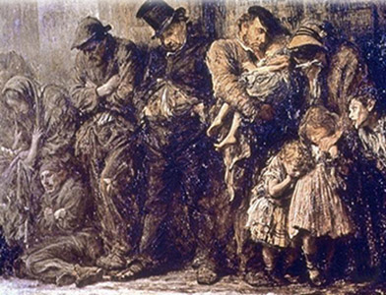
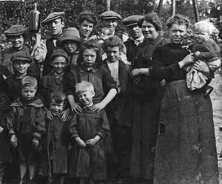
The times of No Bargaining

Slide 3
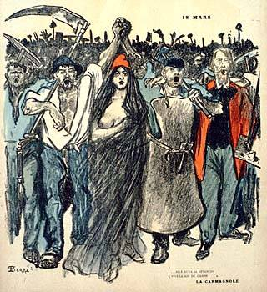
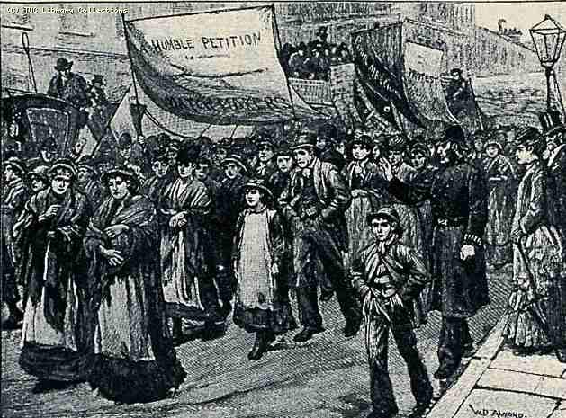
Workers Revolts

Slide 4
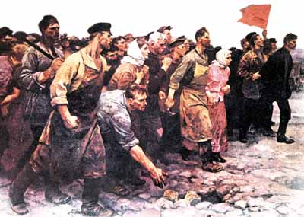
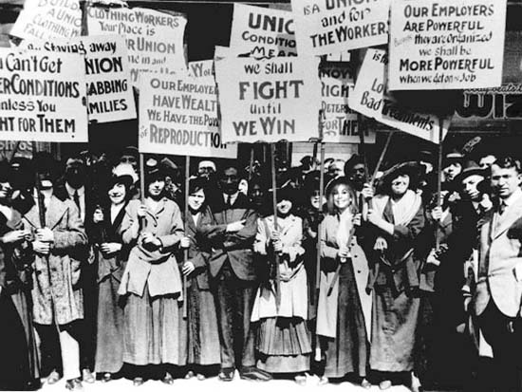
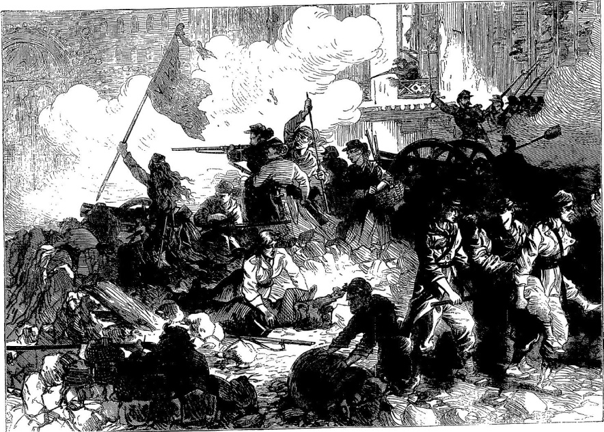
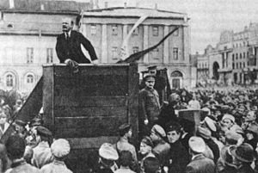
Civil Wars & Revolutions

Slide 5
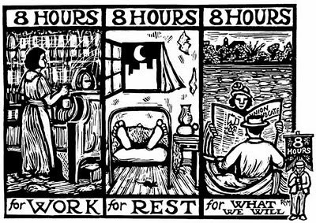
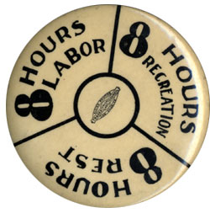
ILO standards in 1919 ~ 1949
8-hour work a day
Right to organize union
Right to collective bargaining
Right to collective action

Slide 6
Workers Rights
Collective Action
Collective Bargaining
Organize

Slide 7
What is Collective Bargaining
Collective bargaining is a negotiation between management and union to jointly decide wage, working conditions, social or economical environment which influence the livelihood of workers or their families.
History of trade union is the history to expand the agenda and topics for bargaining with employers.

Slide 8
Principle of Collective Bargaining
Collective bargaining is determined by power relationship between union and employers.
  Strong union = good collective bargaining
  Weak union = bad collective bargaining
Collective bargaining is not a “talk show” of union leaders, but a collective struggle of union members.
We are united, we bargain. But, we are divided, we beg.

Slide 9
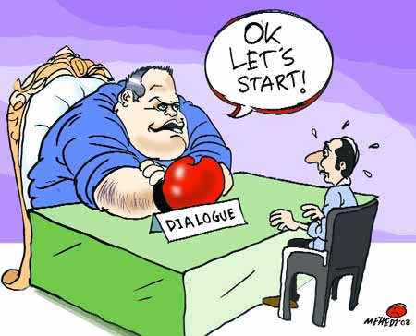
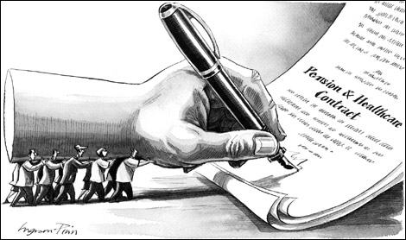
Individual Bargaining versus Collective Bargaining

Slide 10
Flow of Collective Bargaining
1. Preparation
Collect demands & complaints from members
Make union demands (draft CBA from union side)
2. Progress
Make a scenario for each bargaining meeting
3. Conclusion
Make temporary agreement
Final signature with employer
Nominate union negotiators
Report back to members about on bargaining results
Members’ vote on the temporary agreement

Slide 11
Preparation for Collective Bargaining
Evaluate the existing CBAs
Questionnaire survey for union members: demands, complaints, suggestions, ideas
Analyze the questionnaire survey
Make the union proposal (draft CBA).
Decide the union proposal at members assembly or shop stewards meeting.
Nominate union negotiators.

Slide 12
Nomination of Negotiators
Nominate negotiators among union leaders, shop stewards, committed members.
Balanced nomination among different departments, production lines or sections
Nominate as many as possible, because the experience of negotiator is a good chance to train good unionists. They can be the future union leaders.
Also, nominate upper-level union officers as negotiator.

Slide 13
Making Arguments for Union Proposal
Collect company information: financial reports, auditing reports, managerial analysis, cases of other companies in the same industry or the same province, government statistics, any news on company from mass media, legal documents and labor laws.
Think about employers argument against union proposal, and develop counter-argument to employer’s argument.
Make the argumental documents or evidentiary materials against employers argument.
Study and study union documents and materials for mastering them.

Slide 14
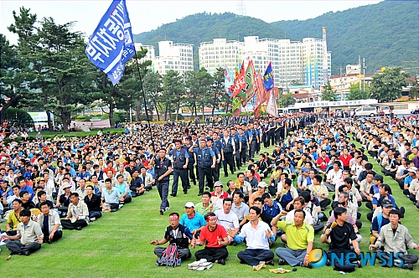
Progress of Collective Bargaining
Send a union letter of bargaining request to employer (if possible, under the name of FOL president or Upper-level union)
The union letter mention the time, place, union negotiators.
Before or after sending the letter, consult with employer on the time and place for negotiation
Inform union members of the fact that union send the bargaining request letter.

Slide 15
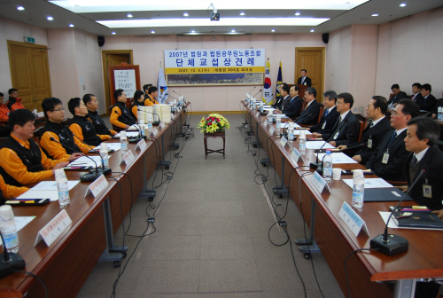
Order of Negotiation Meeting
Declare opening
Nominate the meeting chair (union chair the first meeting, and employer does the next)
Introduction of negotiators from union and employers
Greeting speeches by representatives of both parties
Discussion and agreement on the principles of negotiation.
Explanation about union proposal
Reaction to union proposal from employer side
Declare closing

Slide 16
Principles of Negotiation between employer and union
One meeting in a week (if possible two meetings in a week)
Make sure that the preparation time for collective bargaining during working hours must be paid. (2 or 3 days of paid leave in a week)
Make sure that “real” employer must participate in the negotiation meeting.
Rotation of chairperson between union and employer
Nominate the secretaries of both parties to write the meeting minutes.
If some agenda agreed, both parties confirm the agreed agenda and sign their names on the meeting minutes.
Make the negotiation meeting open to union members and upper-level unions.
Photo and recording is allowed to keep the negotiation meeting transparent

Slide 17
Tactics of Negotiators
Be dignified and confident as equal negotiator with employer
Make sure that every union negotiator speak out evenly and equally.
Plan and decide “who does what”; allocate the roles of “hard-liners” and “soft-liners”, “attackers” and “defenders”.
Chief negotiator (union president) must be not talkative, but cautiously speak.
Negotiators must be united and harmonized in perfect order. Individual action or reaction is not allowed.
Negotiators must wear the same uniform (company or union uniform) .
Negotiators must make their entrance and exit at the same time.

Slide 18
Tactics of Negotiators
Individual contact between union negotiator and employer is not allowed.
In case of the individual contact, the concerned person must inform union of the contact and “what discussed”.
Unity and consensus among negotiators (among union members) is the foundation for winning the negotiation.
Different opinions among negotiators must be discussed and agreed. If agreed, anybody must be committed to it. (the issue of union discipline)
After every negotiation meeting, report back to members or shop stewards about “what is going on, what was discussed, what agreed and disagreed” (leaflets, documents, papers).
During the negotiation meeting, if emergency or disagreement among union negotiators happen, declare or request the adjournment of the meeting.

Slide 19
Tactics of Negotiators
Bring the memo paper and use it in emergency, or if needed for internal communication among negotiators.
Do not speak emotionally or sentimentally. Do not refrain from personal attack (defamation) against employer negotiator.
Do not use violent language, violent action, and not talk roughly and rudely.
Do not speak, based on rumor, speculation, arbitrary judgment.
Be careful for questions led by employers.
Refrain from making surprising action, unplanned proposals, infeasible demands.
Check “who is hard-liners or soft-liners”, “who is real decision maker” from employer side.

Slide 20
Tactics of Negotiators
Make “the real decision maker of employer side” to speak out.
Complain and protest against the arrogant, ignorant, disregarding, defamatory, insincere attitudes of employers in the negotiation.
Minimize proposing the amendment of union proposal (only 1 time or 2 times).
Make “outsiders” a friend: government, police, community people, political and social organizations.
Make sure the regular meetings with union members during the negotiation.
Combine the negotiation with member education, organizing (new member recruitment ).
Develop various events such as ribbon (mentioning union demand) attachment, member assembly, member picnic, sports event, family meeting during the negotiation.

Slide 21
Conclusion of Collective Bargaining
Make temporary agreement with employer
Report back to members about the temporary agreement
Organize members vote for/against the temporary agreement
If a majority of members vote for it, final signature is made between real employer and FOL president (upper-level union president)
Implement evaluation on the CBA from ordinary members (questionnaire survey)
Evaluation meetings by union leaders including upper-level unions

