Slide 1
Income Policy for Workers and National Economy

Slide 2
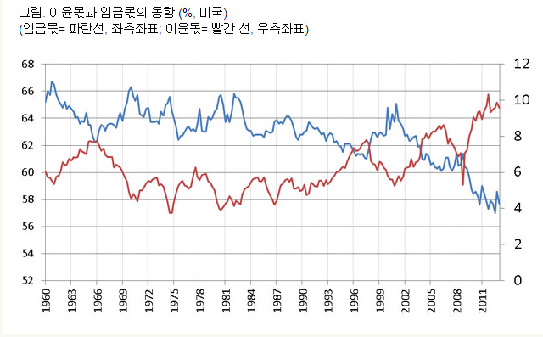
Blue line: portion for wage in US
Red line: portion for profit in US

Slide 3
Income Policy
Pro-capital income policy
  To decrease the ratio of workers wage in national income
Pro-labor income policy
  To increase the ratio of workers wage in national income
Government policies to influence workers’ income
  Tax policy
  Social policy
  Labor market policy

Slide 4
Income Policy
Pro-capital income policy
Pro-labor income policy
Labor flexibility, wage flexibility
Decreasing minimum wage
Deteriorating labor laws
Decreasing corporate tax
Minimizing the scope and application of collective bargaining
Exemption from Income tax for capital profit
Enforcement of Wage restriction
Labor stability, wage stability
Increasing minimum wage
Improving labor laws
Increasing corporate tax
Expanding the scope and application of collective bargaining
Increase of income tax for capital profit
Promotion of wage increase

Slide 5
Ordinary workers (operator-level) monthly wage (USD) by JETRO 2011
2011 GDP per Capita (USD)
By World Bank
Kuala Lumpur: 344
Bangkok: 286
Jakarta: 209
Hanoi: 111, HCM: 130, Da Nang: 200
Phnom Phen: 82
Mumbai: 403, Chennai: 260, Bangalore: 320
Dhaka: 78
Manila: 325, Cebu: 195
Singapore: 1,285
Hong Kong: 1,384
Taipei: 1,008
Seoul: 1,696
Nagoya: 3,804
Malaysia: 9,656
Thailand: 4,972
Indonesia: 3,495
Vietnam: 1,411
Cambodia: 900
India: 1,489
Bangladesh:
Philippines: 2,370
Singapore: 46,241
Hong Kong: 34,457
Taiwan:
Korea: 22,424
Japan: 45,902

Slide 6
Annual wage (USD) 2011
GDP per Capita 2011
Kuala Lumpur: 4,128
Bangkok: 3,432
Jakarta: 2,508
Hanoi: 1,332, HCM: 1,560, Danang: 2,400
Phnom Pehn: 984
Mumbai: 4,836, Chennai: 3,120
Dhaka: 936
Manila: 3,900, Cebu: 2,340
Singapore: 15,420
Hong Kong: 16,608
Taipei: 12,096
Seoul: 20,352
Nagoya: 45,648
Malaysia: 9,656
Thailand: 4,972
Indonesia: 3,495
Vietnam: 1,411
Cambodia: 900
India: 1,489
Bangladesh:
Philippines: 2,370
Singapore: 46,241
Hong Kong: 34,457
Taiwan:
Korea: 22,424
Japan: 45,902

Slide 7
Japan (Nagoya)
254
45,902
45,648
Worker
GDP

Slide 8
Vietnam (Hanoi)
71
1411
1332
Worker
GDP

Slide 9
Korea(Seoul)
2,072
22,424
20,352
Worker
GDP

Slide 10
Indonesia (Jakarta)
987
3495
2508
Worker
GDP

Slide 11
Thailand (Bangkok)
1540
4972
3432
Worker
GDP

Slide 12
Malaysia (Kuala Lumpur)
4528
9656
4128
Worker
GDP

Slide 13
Philippines (Manila)
3900
2370
Worker
GDP

Slide 14
Monthly wages and benefits (USD) for 48-hour work week
International Herald Tribune, May 17 2013
Dhaka: 37 USD
Phnom Penh: 120 USD
Ho Chi Minh: 145 USD
Semarang: 190 USD
Jakarta: 300 USD
Guangzhou: 500 USD

Slide 15
National income for workers
Underdeveloped countries
worker
worker

Slide 16
National income for workers
Developing Countries
worker
workers

Slide 17
National income for workers
Developed Countries
worker
worker
worker
worker

Slide 18
A
National income
National income
workers
workers

Slide 19
B
National income
workers
National income
workers

Slide 20
High Income Society for Workers
Wage increase inside factory
  strong and effective collective bargaining
Social wage (social security) outside factory
  Fair and just taxation system
Strong Union Power

