Slide 1

Unionen's policies and activities regarding gender equality in the workplace and in the labour market
Young women unionist training
Batam, 17-18 October 2018
Carin Hallerström, International secretary
Notes:
My name is Carin Hallerström and I work as international secretary in Unionen
I have been asked to tell you about Unionen’s politics regarding equal treatment, gender equality, equal pay, diversity and work-life balance related to parenthood.
First let me start with some words about Unionen

Slide 2


Slide 3
This is Unionen
Unionen is the largest trade union in Sweden. We are more than 650 000 members in 70 000 workplaces
All white-collar workers at a workplace in the private sector irrespective of their position, educational background or pay level
We have 24 regional offices in Sweden

Slide 4

Gender equality – two main focuses
Policies and practices aiming to close the gender pay gap
Parent-friendly working
life (work-life balance)

Slide 5
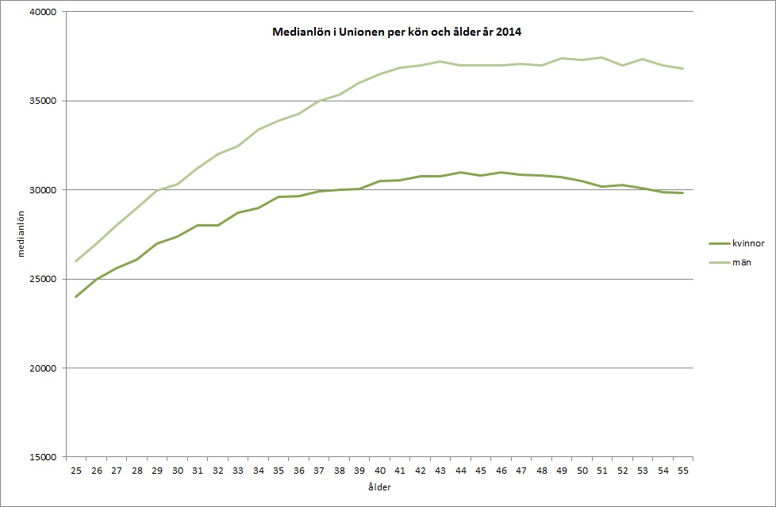
The gender pay gap among members of Unionen
Notes:
The unadjusted gender pay gap in the Swedish labour market is 13,2 per cent.
When you take factors such as education, age, employment rate (full time or part time), sector and profession/occupation into consideration the adjusted pay gap amounts to 5 per cent.
Among white collar workers in the private sector the unadjusted pay gap is 18,6 per cent and the adjusted amounts to 8,1 per cent, so the gender pay gap is wider among white collar workers in the private sector than the average of the Swedish labour market overall.
(The latest available statistics reflect the situation as of 2014).

Slide 6
The Discrimination Act, chapter 3, sections 8-9 Pay survey and analysis
In order to discover, remedy and prevent unfair gender differences in pay and other terms of employment, every year the employer is to survey and analyse:
• provisions and practices regarding pay and other terms of employment that are used at the employer’s establishment, and
• pay differences between women and men performing work that is to be regarded as equal or of equal value.
Notes:
There
The employer is to assess whether existing pay differences are directly or indirectly associated with sex. The assessment is to refer in particular to differences between
• women and men performing work that is to be regarded as equal, and
• groups of employees performing work that is or is generally considered to be dominated by women and groups of employees performing work that is to be regarded as of equal value to such work but is not or is not generally considered to be dominated by women.
are legal and binding provisions in the Swedish Discrimination Act obliging all employers to carry out pay surveys and an analysis of existing pay differentials between women and man who perform equal work or work of equal value.
Unionen produces annual reports on the work with pay surveys and analysis.
When asked whether the company has undertaken the work with pay surveys and analysis:
One out of three do it on an annual basis.
One out of three do it at least every third year.
One out of three have not done a pay survey and analysis within the last three years

Slide 7
Some results from Unionen’s reports on equal pay
34 per cent of the companies identified unwarranted pay differentials that were to be rectified.
39 per cent of the companies identified other measures than pay adjustments that needed to be undertaken.
The undertaking of the work with pay surveys and analysis led to concrete results in six out of ten cases.
The provisions on pay surveys, analysis and action plans for equal pay are effective.

Slide 8
Methods to evaluate the value of work
The most commonly used methods to evaluate the value of work in the areas which Unionen organize are BAS and Analys Lönelots (developed by the Equal Opportunities Ombudsman/the Equality Ombudsman).
In the collective agreements it is stated that the level of difficulty of the work should be reflected in the wages. Some sort of evaluation of the value of each work is common regardless of the provisions on pay surveys and analysis.

Slide 9
Unionen's opinion on the current legislation
All trade unions are in favour of the provisions on pay surveys, analysis and action plans for equal pay.
Unionen as well as all the confederations of affiliated trade unions in Sweden want the provisions on pay surveys, analysis and action plans for equal pay to be semidispositive.
Notes:
The social partners are better suited to take responsibility for the work for equal pay.
Semidispositivity would also enable the social partners to construct tailor-made solutions and models that are effective in different parts of the labour market.

Slide 10
Bargaining autonomy
In Unionen’s opinion the provisions on pay matters in the 3 Chapter of the Discrimination Act are not an obstacle to the bargaining autonomy, in the same way as the prohibition of discrimination does not in an undesirable way constitute a limitation of the bargaining autonomy.
Carrying out the pay survey and analysis is a necessary way out securing the quality of the wage process from a gender equality perspective.
Bargaining autonomy does not include the right to set discriminatory wages.
However, the provisions should be semidispositive.
Notes:
On the contrary
The employers are dismissing the trade unions proposals to include agreements on pay surveys and analysis in the collective agreements and one of the arguments for that is the fact that it would be a case of double regulation and that the employers would face the risk of double sanctions.
The Board against Discrimination (failure to comply with obligations according to the Discrimination Act)
Labour Court (disputes regarding breaches of collective agreement)

Slide 11
How are the regulations affecting employees remuneration structure?
Although this question has not been studied it is not the opinion of Unionen that the remuneration structure has been negatively influenced, for instance with regards to wage spread.
Tens of thousands of employees have had their salaries adjusted thanks to the provisions, which is far more than has been accomplished by bringing pay discrimination cases to the labour court.
Another positive effect of the work with pay surveys and analysis is that many companies have achieved a more systematic and less arbitrary local wage formation process.

Slide 12
Parent-friendly working life
Annual reports on success factors as well as needs for
improvement regarding a parent-friendly working life
The most important success factors for a parent-friendly working life are:
  The possibility to influence when and where you work
  That meetings are not being held too early in the morning or too late in the afternoon
  That managers who have children act as good examples and go on parental leave, stay at home to care of sick
  children etc.
Notes:
Another one of Unionen’s top priorities regarding gender equality is to achieve a parent-friendly working life. In order to promote this Unionen produces annual reports on success factors and areas which need improvement. Although the present situation is far from perfect we do see an improvement in the number of companies and organizations that take active measures to facilitate the combination of gainful employment and parenthood.

Slide 13
The Discrimination Act, chapter 3, section 5 Combination of employment and parenthood
Employers are to help enable both female and male employees to combine employment and parenthood.

Slide 14
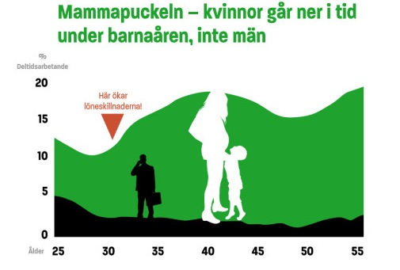
“The Motherhood Hump”
Notes:
In the labour market overall:
30 per cent of the employed women work part time.
11 per cent of the employed men work part time.
Among Unionen's members:
16 per cent of the women work part time, 3 per cent of the men.
The share of women who work part time increases in the ages where many of us become parents.
Becoming a parent does not influence the share of men working part time.
The pay gap between women and men widens when the share of women who work part time increases.
Being away from the workplace to a larger extent than men out women at a disadvantage and a risk of:
Less internal training and skills development
Smaller pay increases
Decreased labour market movability
Lesser likelihood to be promoted or become a manager
Parenthood should never put an employee at a disadvantage. It is particularly worrying that there are clearly visible patterns indicating that parenthood is a career brake for women in particular.

Slide 15
Parenthood – a career brake for women?
3 out of 10 of the respondents work part time in order to successfully combine work and parenthood (48 per cent of the women, 19 per cent of the men)
1 out of 4 have refrained from applying for a new job because they are parents (37 per cent of the women, 24 per cent of the men)
More than 1 out of 3 women feel that the parental leave has affected their career opportunities negatively, 16 per cent of the male respondents feel the same way
Nobody should have to choose between a thriving professional career and an active parenthood

Slide 16
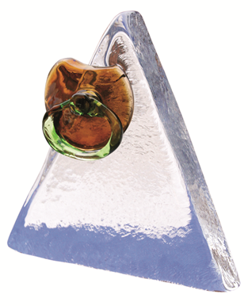
Guldnappen (The Golden Pacifier)
Unionen's annual gender equality award
Guldnappen is awarded to the most parent-friendly workplace in the private sector of the Swedish labour market
The list of former winners include
IKEA, Ramböll and Volvo Car
Corporation
Notes:
Unionen has an annual award called The Golden Pacifier (Guldnappen) which is awarded to the most parent-friendly workplace in the private sector of the Swedish labour market. Former winners include IKEA, Ramböll and Volvo Car Corporation

Slide 17

Everything to gain – from words to action for gender equality in the workplace
Success factors for gender equality in the workplace:
An outspoken statement from the top
management clarifying that gender
equality is a priority in the company
Gender equality must permeate the
management and leadership
A systematic and ambitious work with
active measures to promote gender
equality
Notes:
In order to promote an active work for parent-friendly workplaces Unionen has produced a book in which company leaders and managers as well as union representatives share their thoughts on why it is important and profitable to carry out a systematic and ambitious work for gender equality. They also offer a description of how they go about promoting gender equality in their companies.
The interviewed companies are Boliden, Coca-Cola, IKEA, Polarbröd and Ramböll.

Slide 18
Other gender equality issues that are important to Unionen
Breaking the gender segregation in the labour market – for instance, how do we encourage more young women to educate themselves and work in the IT sector?
Psychosocial work environment, especially regarding work-life balance, stress and work-related sick leave
Prevention of harassment and sexual harassment in the workplace

Slide 19

Thank you for your attention.

