Slide 1
IF Metall
Gender equality in the workplace
Magnus Palmgren

Slide 2
Gender equality
The overarching principle is that everyone, regardless of gender, has the right to work and support themselves, to balance career and family life, and to live without the fear of abuse or violence.
Gender equality means that women and men enjoy the same rights and opportunities in all areas of life, for example equal opportunities on the labour market, shared responsibility for the home and children and economic equality.

Slide 3
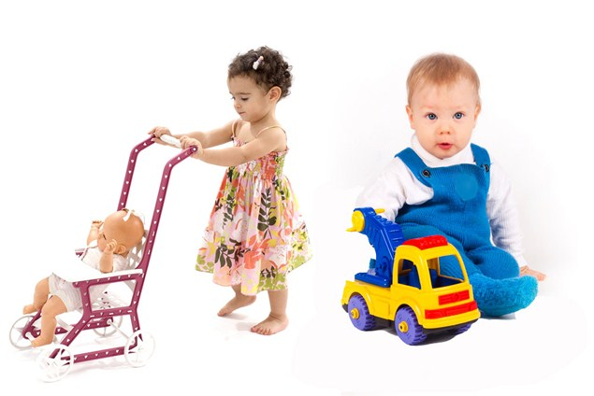

What is gender?
Gender refers to the socially determined roles, responsibilities, behaviour, characteristics of women and men in a given culture

Slide 4
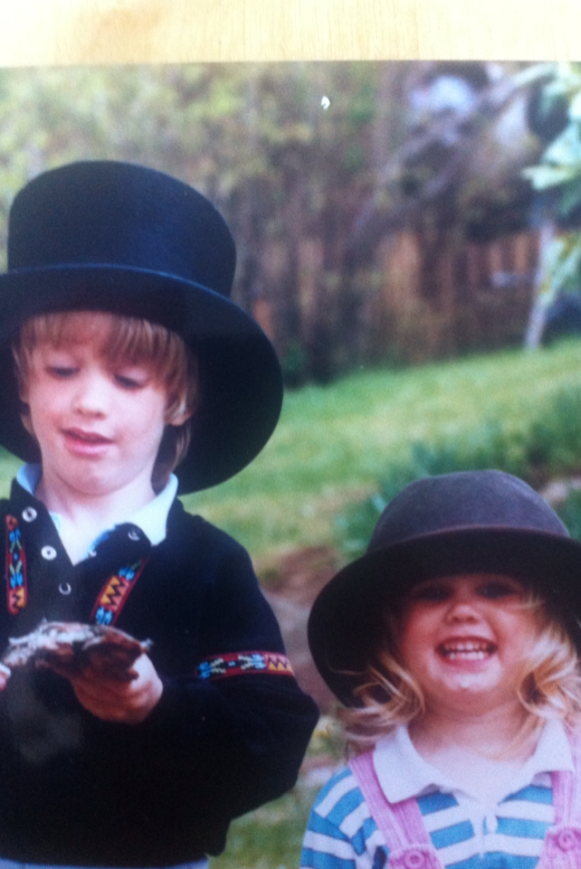
What is gender?
Socialization at home, school, media, etc.
Assimilated and learned, can change over time and can vary within a given culture

Slide 5
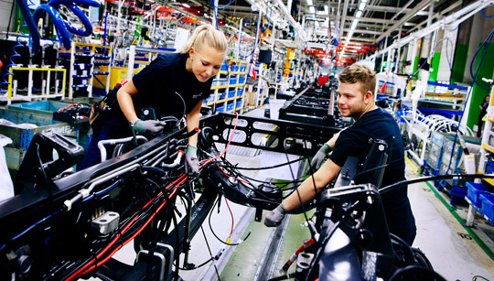
This is IF Metall
246 576 active members
46 349 women (19%)
200 227 men (81%)
26 799 union representatives, of which 18% are women (4 787)

Slide 6

Typical Assignments
Men:
Chairperson of trade union branches and clubs
Negotiations
Collective bargaining
Safety issues
Women:
Secretary
Education
Equality
Culture

Slide 7
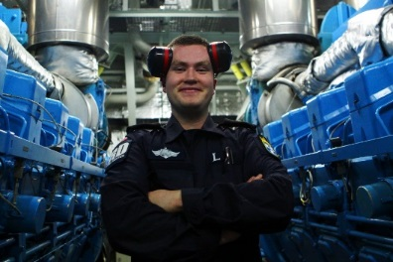
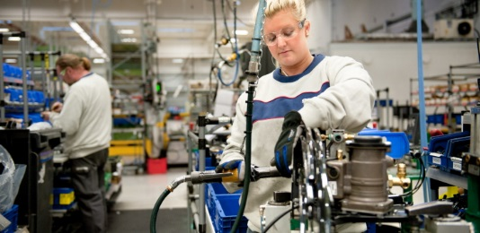
Gender roles at the workplace
No special provisions for women in the collective agreement
Division of labour is roles and tasks assigned to women and men based on perceived characteristics and attributes, instead of ability and skills
In general, these different roles usually result in women having different and less access and control than men to resources and decision-making processes

Slide 8
Some figures
4 200 SEK = less paid to women in average per month (life time 3.6 million kronor)
1 hour = the time women work for free every day (since they are less paid)
12,5 % = wage difference between women and men in average

Slide 9
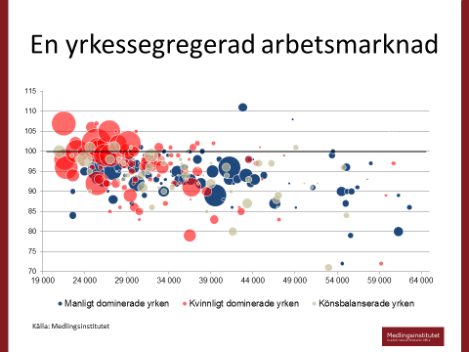
Male vs female professions

Slide 10
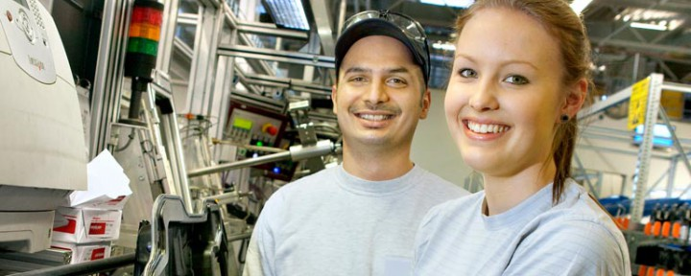
Women and men at work
All employers must actively pursue specific goals to promote equality between men and women.
The law prohibits discrimination and obliges employers to investigate and take measures against any harassment.

Slide 11
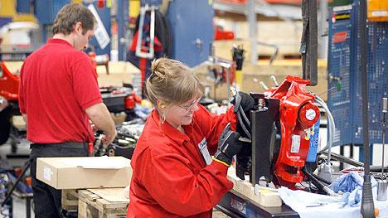
Who benefits from equality?

Slide 12
Why is there gender inequality in the workplace?
Not equal access to education
Gender based tasks
Stereotypes
Sexual harassment
Women taking care of family

Slide 13
Discussion points
Does the workplace have working positions which are dominated by women?
Does the workplace have working positions which are dominated by men?
Do women and men have the same opportunity in training?
Is it important to have equal rights? Why? Why not?
What can you do for equal rights for women and men?

