Slide 1
Shop-steward Manual

Slide 2











International Trade Secretariats (ITSs)
Global Union Federations
(GUFs)

Slide 3
IndustriALL 5 Strategic Goals
Defend workers’ rights
Build union power
Confront global capital
Fight precarious work
Promote sustainable industrial policy

Slide 4
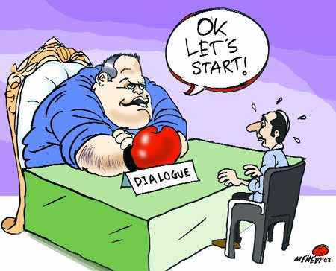
Who are you?

Slide 5
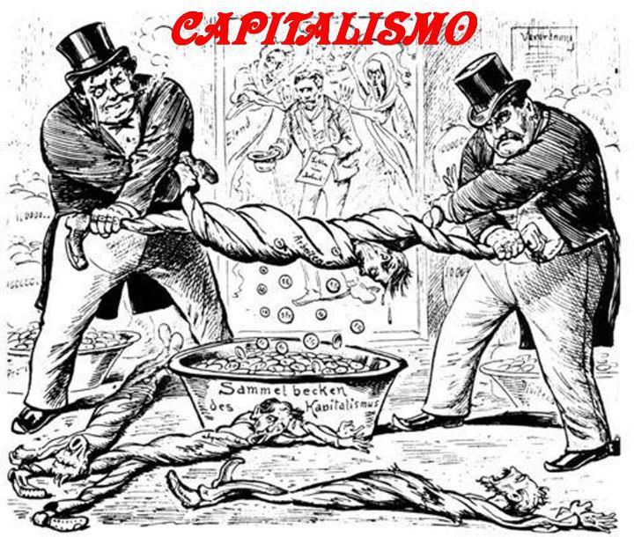

Slide 6
What is union?
Union is a workers’ organisation.
Union fights for workers’ rights and worker’s interests.
Union has nothing to do with employers’ right and employers’ interests.
Union is a collectively united organisation by workers and among workers to fight for their rights and interests.
Workers must have the freedom to join the existing unions, or to form their own union, if there is no good union for them.
We call this right the Freedom of Association (ILO C87), or the right to collectively organise, or the right to collectively unite.

Slide 7
Who represent employers’ interests and rights?
Employers’ organisations fight for employers’ rights and interests.
There are employers’ organisations. For example,
  APINDO in Indonesia
  MEF in Malaysia
  MONEF in Mongolia
  VCCI in Vietnam
  KEF in South Korea
Have you ever seen any employer’s organisation to fight for workers’ rights and workers’ interests?

Slide 8
Who is a bridge between workers and employers, especially in dispute?
Union fights for workers’ rights and interests
Employers’ organisation fights for employers’ rights and interests.
When tensions and disputes between workers and employers grow up to a destructive level, a bridge is needed for conciliation, mediation, and arbitration.
Who can play the role of bridge between workers and employers?
This role of bridge (conciliation, mediation, and arbitration) is taken by the government.
This is the reason why democratic, responsible, and transparent government is important to build up ‘industrial peace’.

Slide 9
Part 2. What are industrial relations?

Slide 10
What is industrial relations (labour relations)?
Industrial relations are social relationship of production (work) between workers and employers at company, industry, national and global economies.
Company is a playing ground for the game of industrial relations between workers and employers.
Also, company is a battlefield of social relationship of production (work) between workers and capitalists.
Industrial relations are human-to-human relationship between workers and employers, not human-to-organisation relationship between workers and company (enterprise, corporate)

Slide 11
Employers are same with company, or different from company?
Employers are different from company.
Company has its own legal person (entity). Employers have their own legal entity.
As workers’ wage comes from company money, employers’ remuneration comes from company money.
If employers use company many for their own personal purpose, they go to jail on charges of corruption, bribery, and embezzlement.
So, company money is different from employers’ money.
In industrial relations, workers’ counterpart is not company which is not alive, but employers who are alive and control company.
Unionists have to pay our attention to social relationship of production (work) between workers and employers (capitalists).
Unionists must be careful about the myths of commodity fetishism, money fetishism, machine fetishism, technology fetishism, as well corporate fetishism.

Slide 12
Industrial Relations
Global level
Workers
Employers
National level
Industrial level
Company level
Workplace level

Slide 13
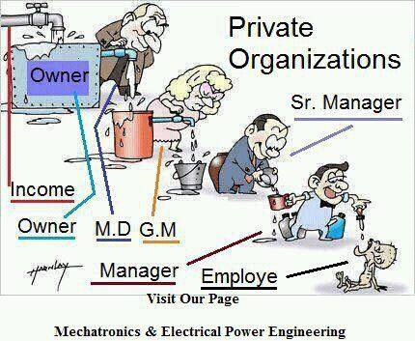

Slide 14
Part 3. What are workers’ rights and workers’ interests?

Slide 15
Relationship between rights and interests
Union is a workers’ organisation fight for workers’ rights and workers’ interests.
What are workers’ rights? And what are workers’ interests?
Interests are something that we can enjoy, and that make us happy and comfortable.
Think about “what make workers happy and comfortable inside and outside factory?”.
Rights are something that we must have for the purpose of protecting us from others such as employers.
Think about, “what protect workers inside and outside factory, especially from employers?”.
Between rights and interests, what are more important and prior to another?
In that sense, rights are weapon for hunting and interests are animal to be hunted.
If we have good weapons, our hunting results will be good.
So, if we have good rights, we will have good interests. If we have poor rights, we will have poor interests.
This is the reason, in general, why employers are very reluctant to recognise workers’ rights inside and outside factory.

Slide 16
Rights and interests for workers
Rights
Interests
Right to collectively unite
Right to collectively bargaining
Right to collectively act
Right to information
Right to consultation
Right to participation
Right to time for union activity (full-time unionist paid by company)
Right to space and resources for union activity (provided by company)
These 8 rights are least or minimum to be achieved by workers and for workers to make industrial relations sound and democratic.
Good wage, good allowances and good bonus
8-hour work a day 48-hour work a week with good income
Paid leaves, holidays, vacations,
Safe workplace
healthful meal and good canteen
Clean toilet
Good ventilators, air-conditioners
Good and clean uniforms
Job training and skills upgrading
Maternity benefits and facilities
PPE (Personal Protective Equipment)
Never ending list, ... … … … …

Slide 17
How workers achieve workers’ rights and workers’ interests, through what?
We know about the history of workers’ struggles and revolutions against capitalist factory system in 17th, 18th, 19th, and 20th centuries.
A lot of revolts, uprisings, and revolutions have been made by workers for the purpose of making their works and lives humane and civilised.
In response, many national governments started to make labour laws in the 19th century to appease challengers of the ruling regime.
Also, at global level, the International Labour Organisation (ILO) was set up in October and November 1919 to achieve ‘industrial peace’ by making internationally-applied labour law system.
As a result, workers’ interests and rights have been placed into national laws and international standards in the 20th century.
Finally, the right to collective bargaining such as ILO Convention No. 98 (1949) has been placed into national laws and international standards for the purpose of empowering workers to improve workers’ rights and interests inside and outside factory.
The history shows the fact that the effective recognition and full implementation of workers’ right to collective bargaining are the most peaceful and harmonious way to achieve industrial peace.

Slide 18


Slide 19
Part 4. What is collective bargaining?

Slide 20
Collective bargaining for whom?
It is important to understand the meaning of ‘collective’, which means that workers are collectively organised through the union. So, ‘collective’ means "by workers, of workers, and for workers”.
The reality show that an individual worker is easily ignored by employers. He/she cannot negotiate with employers on his/her working conditions and terms of employment such as work hours, rest time, wage, etc.
The history teaches us that when workers are collectively united and organised through the union, they have the power to negotiate with employers.
If the workers’ collectively united power is strong, the workers’ bargaining power can be strong. But, if the workers’ collective power is weak, their bargaining power will be weak.
It is important to understand that collective bargaining is the right for workers, but the duty for employers. Because of this reason, if employers do not accept the union’s demand of collective bargaining, it is regarded as unfair labour practices and treated as criminal cases in many countries.

Slide 21
Collective bargaining for what?
What must be negotiated between workers and employers in collective bargaining? They are workers’ rights to guarantee the freedom of union activities and and workers’ interests to improve workers’ conditions inside factory and livelihoods of their families outside factory.
Workers have made the products and the services, creating wealth and profits for company. Workers have followed the rules of employment or company rules by doing overtime or weekend work, also by meeting the productivity target set by employers.
Furthermore, Workers have maintained ‘industrial peace’ without collective action such as work-to-rule, slow-down, picketing, demonstration, rally, occupation of factory, or strikes.
This means that workers have completed their duty.
So, collective bargaining is the time for workers to rightfully demand company’s compensation for workers’ sacrifice (exploitation). Also, collective bargaining is the time for employers to complete their duty to share the company’s wealth and profits (made by workers) fairly and transparently with workers.

Slide 22
Collective bargaining is a ‘Give-and-Take’?
Collective bargaining is only ‘TAKE’ for workers, as workers have already completed their duty to produce company’s wealth and profits by being exploited, maintaining industrial peace and harmony inside and outside factory.
In this sense, collective bargaining means a ‘Workers-already-gave, So the-time- for-workers-to-take’.
As workers have already used their physical and mental energy (labour power: sacrificing their freedom of time and space) to produce company’s wealth and profits, unless workers are neither fairly compensated with nor transparently shared with company’s money through collective bargaining, workers always remain as ‘loser’, but employers remain as ‘winner’ forever.
So, without good collective bargaining, the ‘Win-Win’ is impossible in reality.
Only when we have good collective bargaining and good CBA, we can change the confrontational relationship into harmonious one.

Slide 23
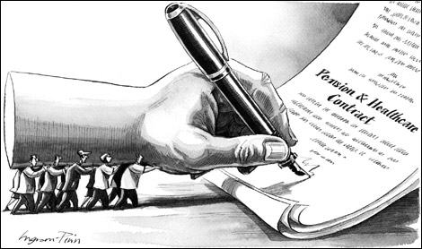
“Collective”
“Bargaining”

Slide 24
Part 4. what is collective agreement?

Slide 25
Collective agreement for whom, for what?
CA is not the rules of employment or company rules. CA is not a booklet related to company policy.
Collective agreement (CA) is the results of collective bargaining.
If workers’ collective power is strong, workers’ negotiation power will be strong, naturally resulting in a good quality of collective agreement. So, the level of workers’ collectively united power determines the quality of collective agreement.
Collective bargaining is the right for workers to be compensated for their sacrifice of labour power which was already ‘exploited’ by employers for producing company’ wealth and profits.
So, collective agreement is only for workers, nothing for employers. This means that all the CA articles must be good for workers.

Slide 26
Main chapters of collective agreement
Rights for workers
Interests for workers
Guarantee of the freedom of union activities (non-interference and no previous authorisation)
No anti-union discrimination (unfair labour practices) to dominate and control the union
Union freedom to express workers’ opinions and disseminate union documents inside factory
Information (company finance, new technology), consultation, and participation in decision-making of company policy (personnel, disciplinary procedures and grievances system, job transfer, recruitment and dismissal, new machine, restructuring, relocation)
Time for union activities (full-time unionist, part-time unionist paid by company)
Space and resources for union activities (provided by company)
Work hours, rest time, leaves, holidays, overtime regulations
Wage, bonus, allowances
Maternity protection, childcare facilities maternity leaves, menstruation leave or care, anti-sexual violence policy
Occupational safety and health, paid sick leave, OSH Committee, medical check-up, personal protective equipment (PPE), good uniform and shoes
Healthful meal, decent canteen, clean toilet
Company welfare, dormitory, housing support, commuting support, children support
Job security, job training
Protection for workers’ confidential information (marriage, sexual orientation, family, disease, religion, political ideology).. …. …. ….. (never end)

Slide 27
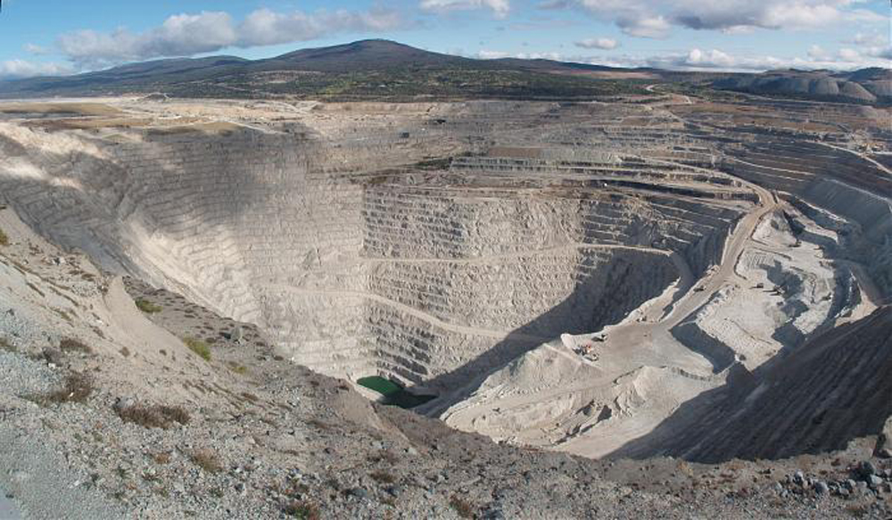
Well-functioning industrial relations
“Exploitation” vs “Sustainability”

Slide 28
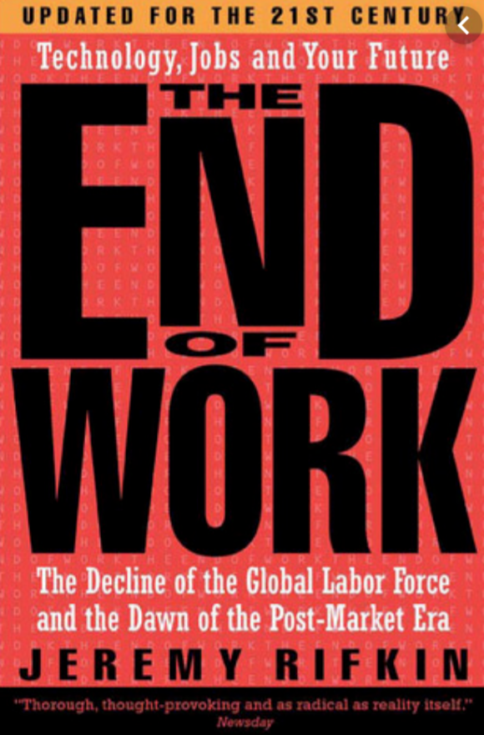
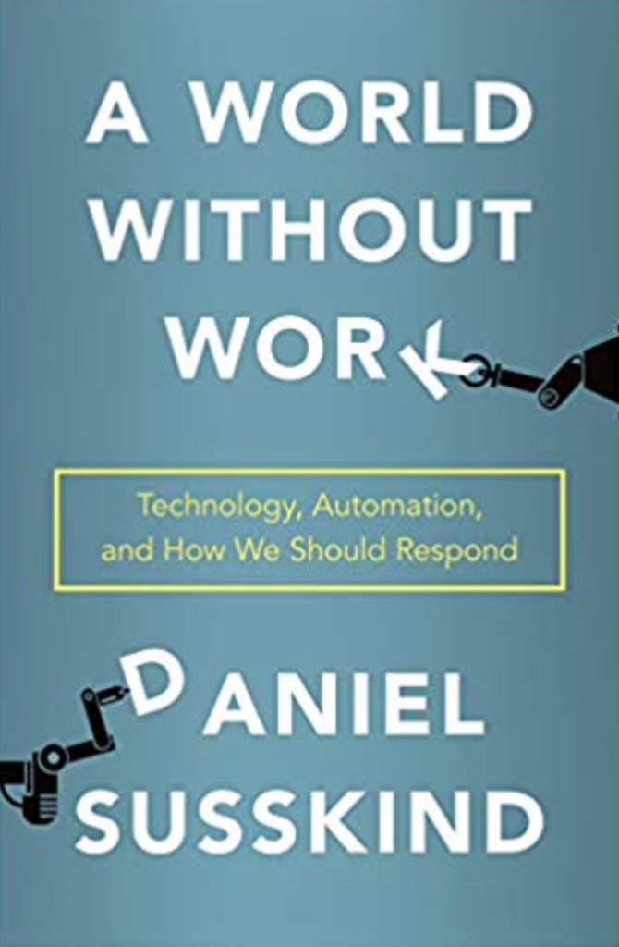
책 제목을 해석하세요

Slide 29
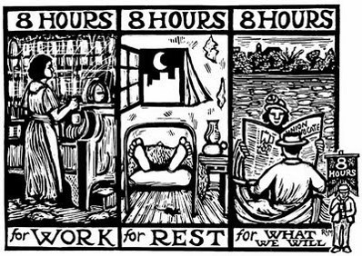
Old Future ??

